Slide 1





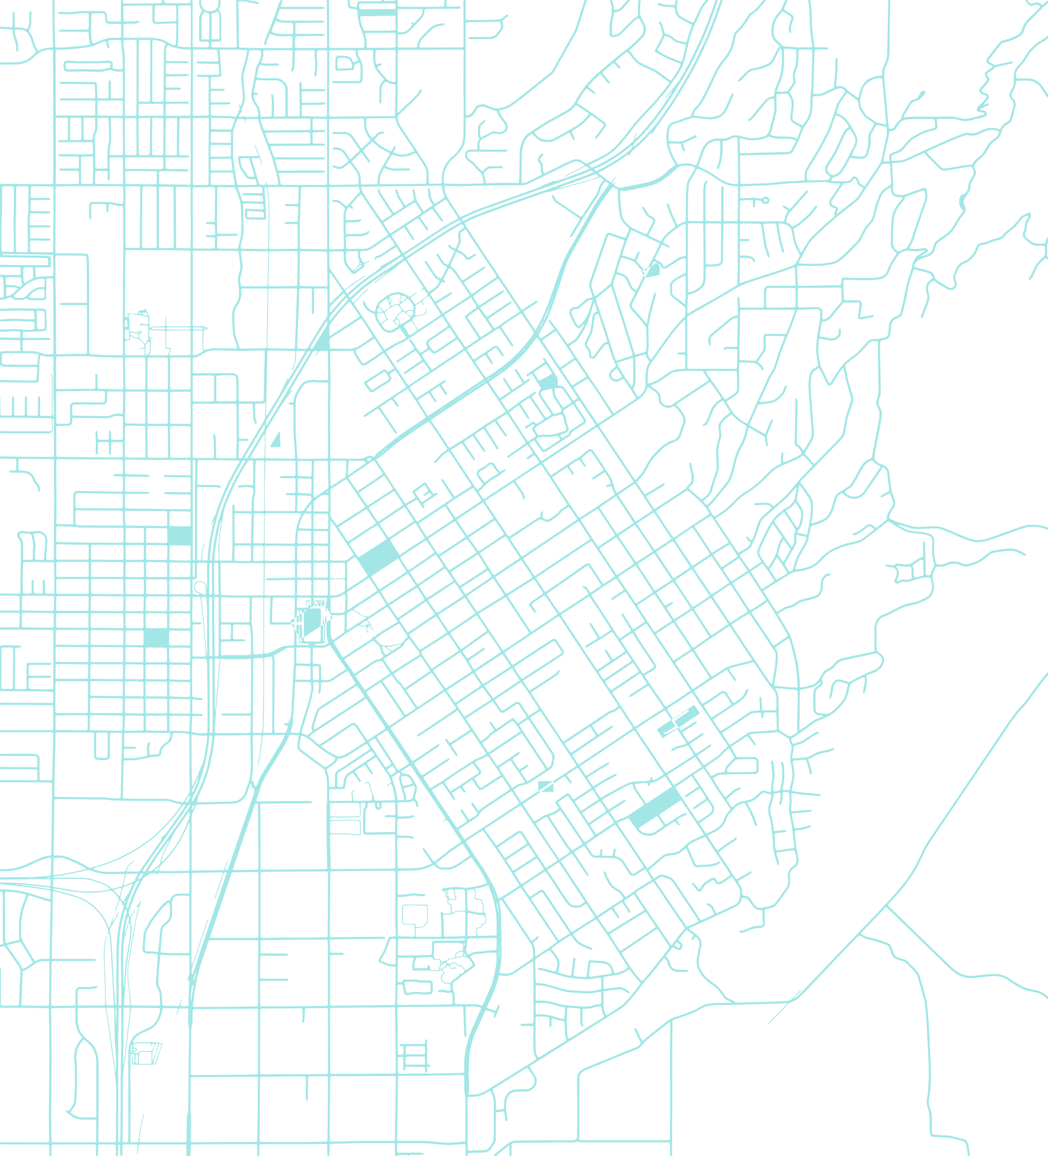


The Vision of a Railroads Data Model for ArcGIS
Jim Barry
Senior Solution Engineer, Railroads
Esri
Notes:
Esri Corporate Template-Light v4.2
April 7, 2023

Slide 2

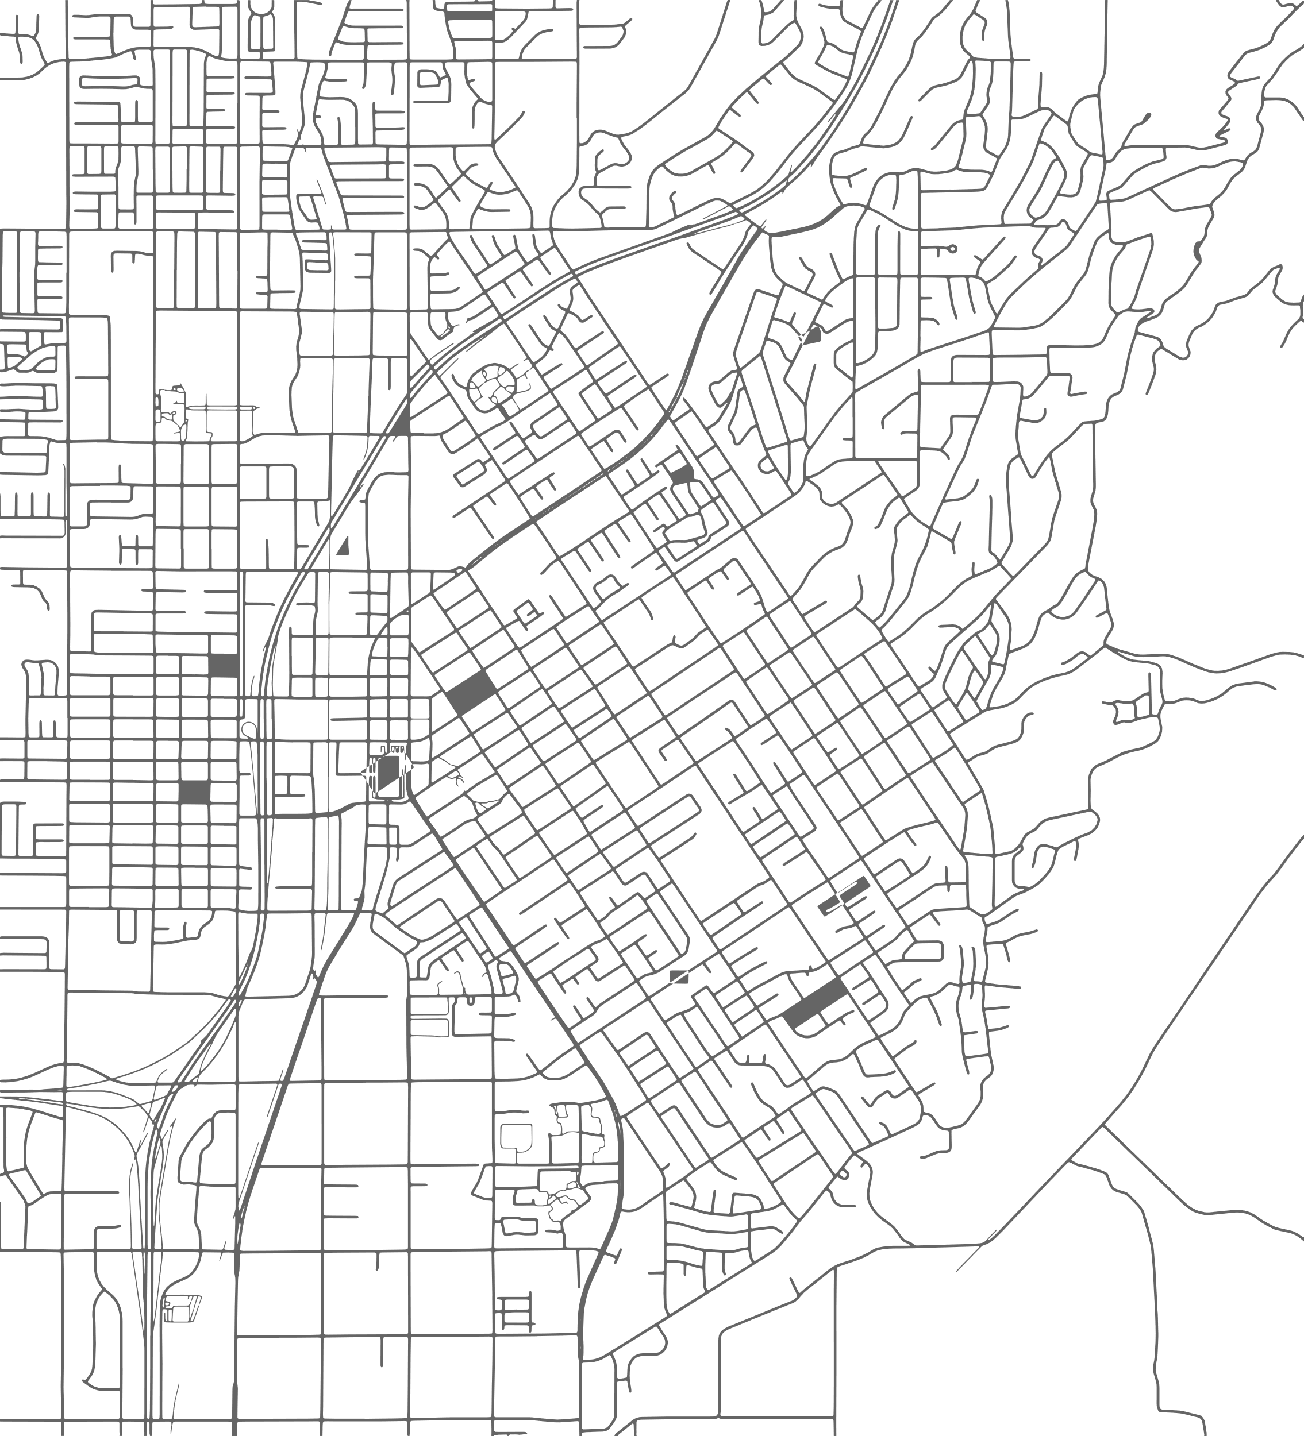
Esri Industry Data Models
Esri has built and maintains data models for the following industries
Natural Gas
Electric
Water
Sewer
Storm water
District Heating
& Cooling
Data models completed in 2023
Ports
done!
Airports
done!
Railroads
-drafted-

Slide 3
Why a data model for Railroads?
Railroads newer to GIS
A starting point that fully exploits GIS capabilities compatible with industry standards
Railroads established with GIS
Ideas for extending your database design
Capabilities you’re getting started with: schematic mapping, LRS, utility networks, etc
Foundation for solution building
Esri solutions, Esri partner solutions, open source projects, etc
Facilitates data exchange
Supports Web GIS architecture

Slide 4

DATA MODELS
-------------------
-----------------
Data Models
-----------------
Data Models

Slide 5

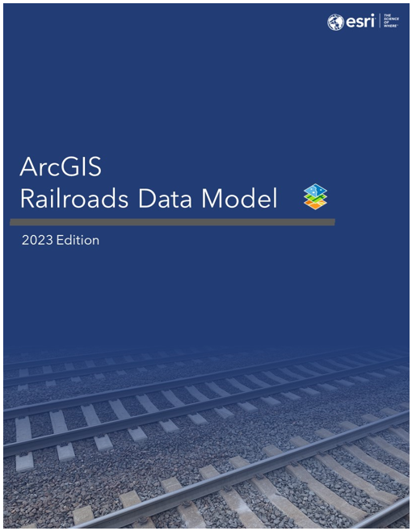



Design Considerations
Industry Compatibility
PTC
RIGIS™
NARN
RIGIS™ is a trademark of Railinc Corp.

Slide 6
Design Considerations
Industry Compatibility
PTC
RIGIS™
.
ArcGIS
RIGIS™ is a trademark of Railinc Corp.

Slide 7
Design Considerations
Industry Compatibility
PTC
RIGIS™
NARN
ArcGIS
RIGIS™ is a trademark of Railinc Corp.

Slide 8


Design Considerations
x
x
GIS Capabilities
Schematic mapping
Linear referencing
Network routing and analysis
Trace Networks
Real-Time mapping
Field mobility
Parcel management
Imagery
3D mapping
Straight-Line diagrams
Artificial Intelligence
+
+
+
+
+
+
+
+

Slide 9

Deliverables
Data Dictionary
ArcGIS Pro Project Package
Sample Dataset (File Geodatabase)

Slide 10
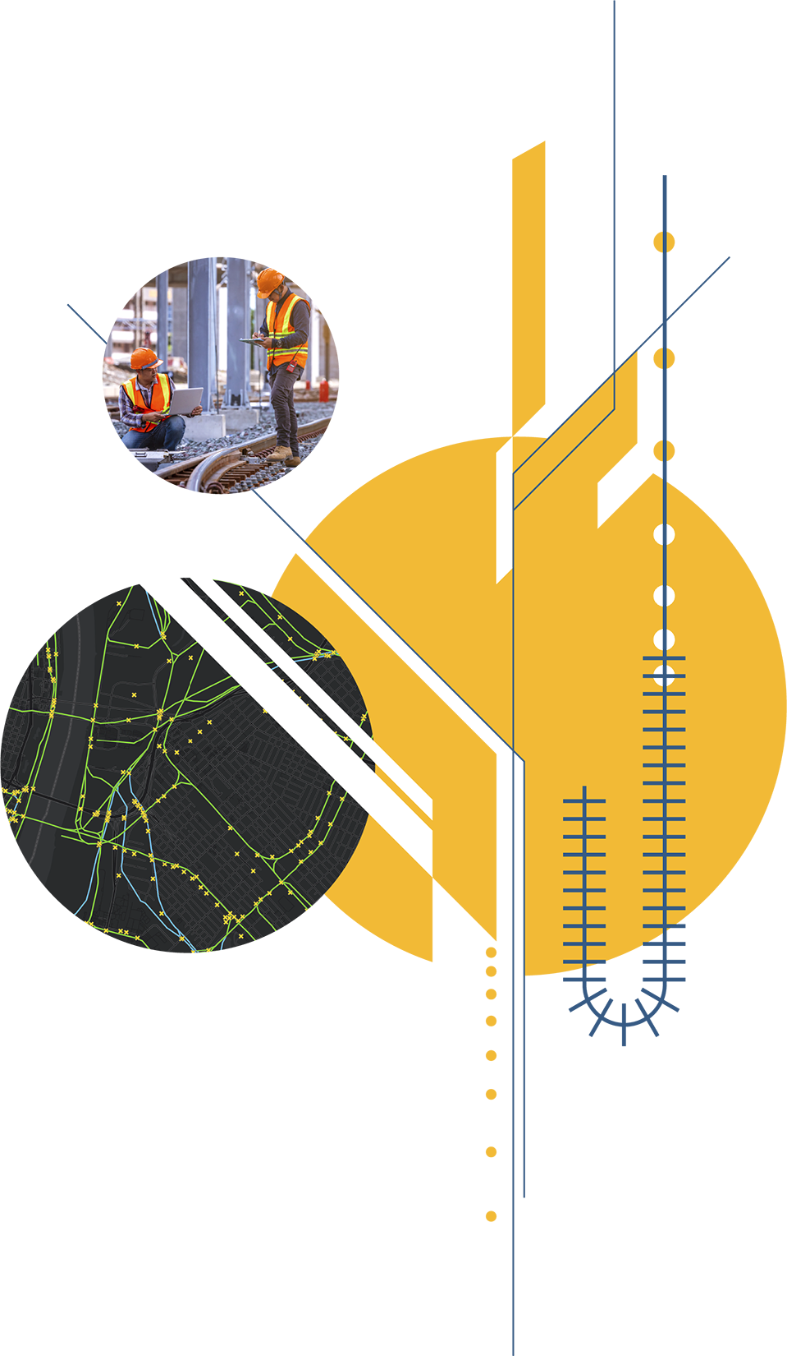



Copyright © 2023 Esri. All rights reserved.

Slide 11


Slide 12



Slide 13





Slide 14
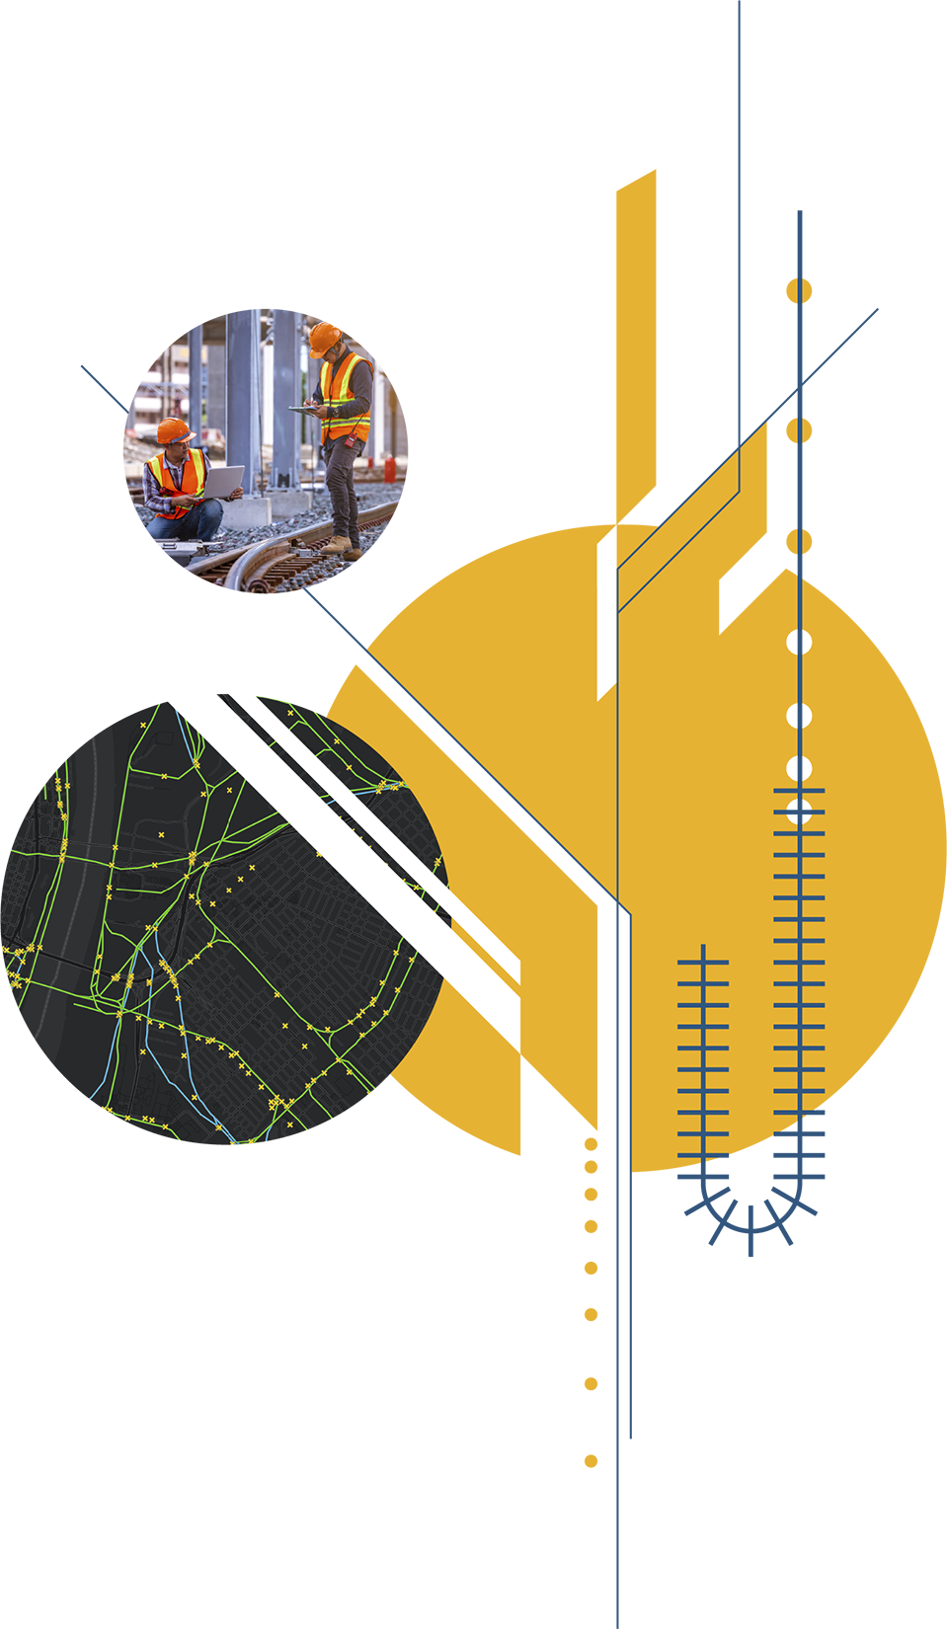

Copyright © 2023 Esri. All rights reserved.

